Slide 1
Racing Related games
By Thomas Simmons
S176601

Slide 2
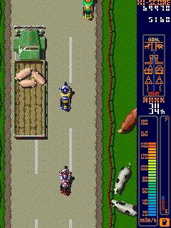
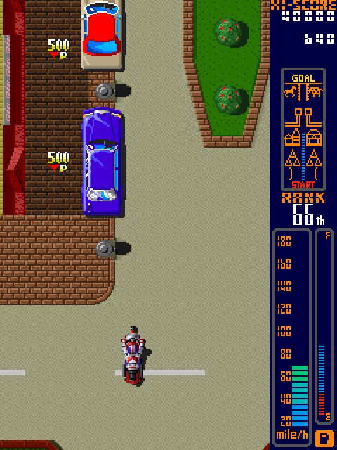
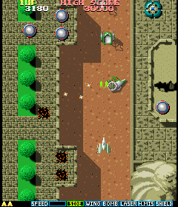
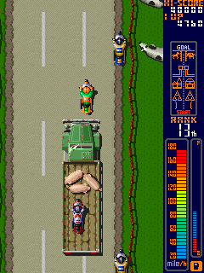
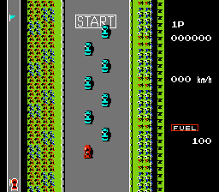
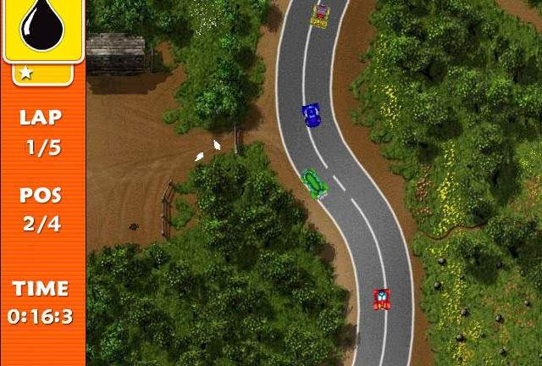
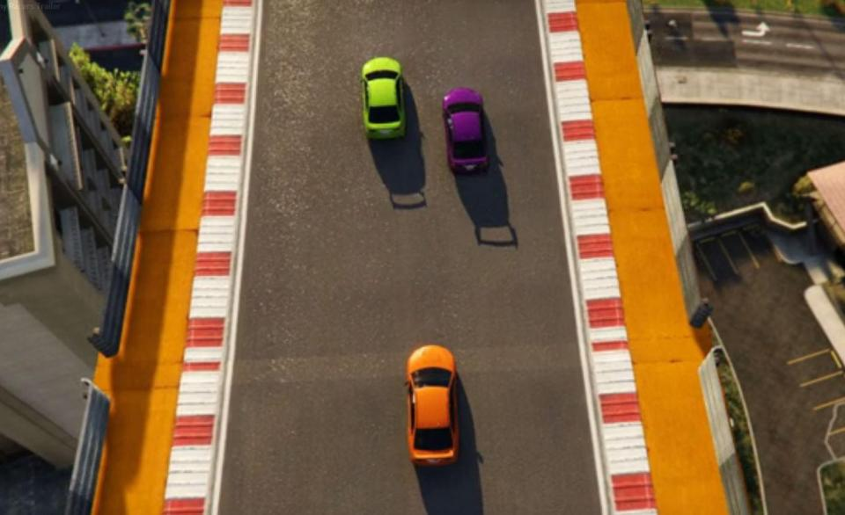
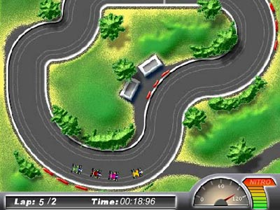
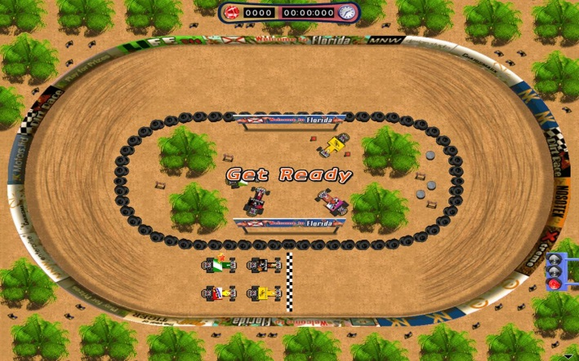
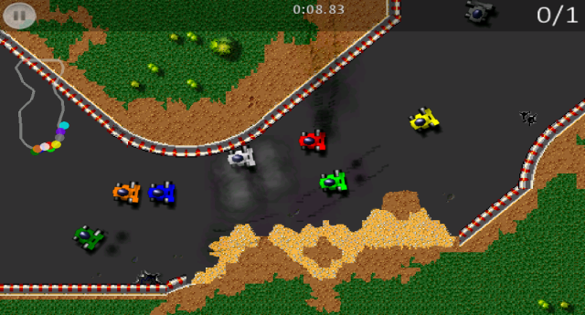
Birds Eye View Mood board

Slide 3
Birdy Eye View Analysis
These games are mostly 2d pixelated games. They include:
Endless runner high scores
Circuit race for up to 8 racers
Oval racing till fuel runs out (endurance)
Vast majority of games are single player

Slide 4
Unique Properties
Different types of HUD’s available, they include:
Time limit
High score
Engine temperature
Boost/ health and damage bars
Time limit
The flexibly of add ons we can have
The developer can make the game 2.5D with the cars being 2D and the environment being 3D
Car customisation
Random spawning of obstacles and power ups

Slide 5
Possible Problems
These types of games are very common on free game online websites such as miniclip and kongregate meaning we’ll have to find an very specific unique mechanic in the game in order to stand out from the rest.
Randomly spawning scenes
The possibility of needed an AI system
The possibility of having HUD related issues with the player if it is to heavily populated

Slide 6
Possible USP
More than one player can play together in one scene and can either play against the system and see how far up the road they can get to.
Or players can play against each other and try to destroy each other using the environment scene given.

Slide 7


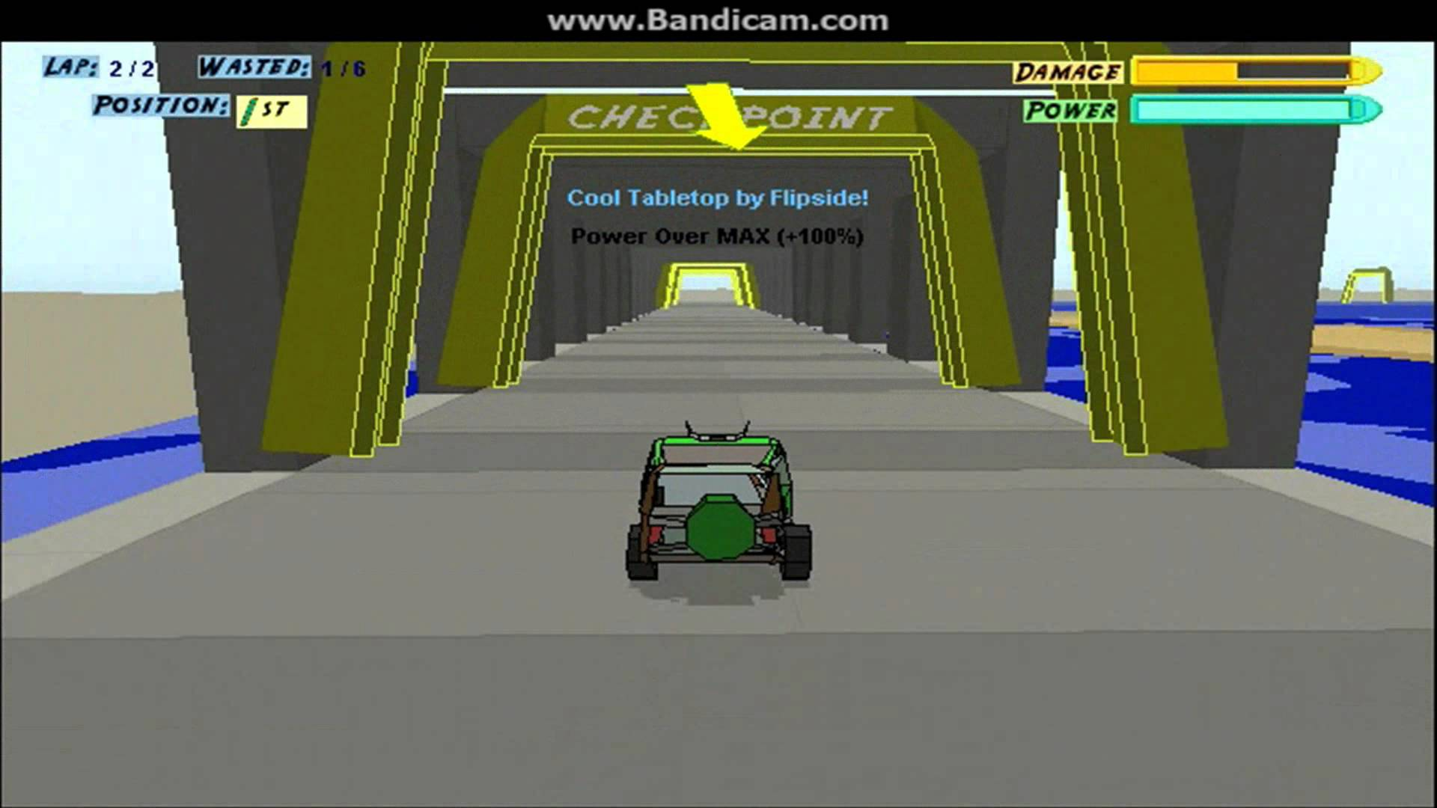
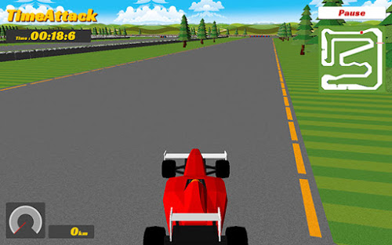
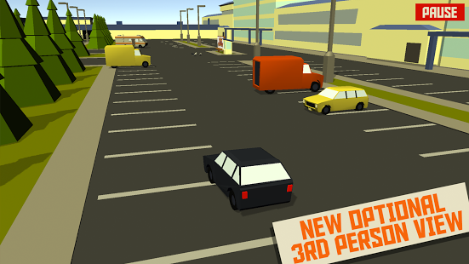
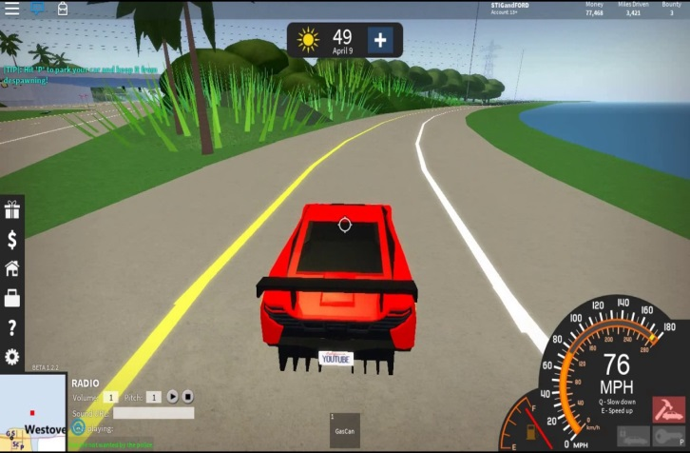
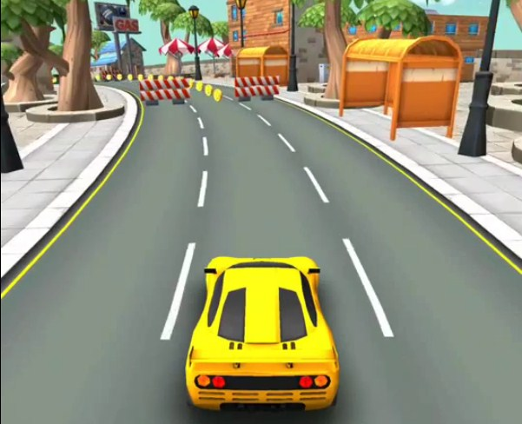


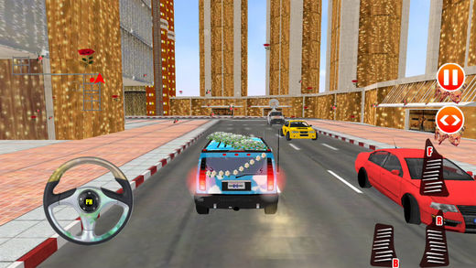
Third Person Racing Games

Slide 8
Third Person Analysis
These games tend o be either:
Endless runner collecting coins
Car parking, driving simulations
Sprint/circuit racing
multiplayer option making them very competitive.
Usually 3D based

Slide 9
Unique Properties
Vehicle Customisation available to the players
Players can use coins/ gems to purchase upgrades
Parking simulations can be very competitive yet easy to make
An 2.5 environment is possible
Varity of HUD components that can be used

Slide 10
Possible Problems
Endless spawning of 3d environments can cause the file to be very large.
Animations of the cars turning can take a lot of time to complete
In game store can take a while to implement

Slide 11
Game Demographics 2014
47% of gamers are women in America
29% of gamers are over the age of 50 years old
16% of gamer kids play with parents
40% of gamer kids with friends
17% play with their spouse or carer
89% of parents watch over what there children purchase on games
Average age of players in America is 30 years old and 35 for the UK
36% play games on their smart phone/Tablet
32% of players are 18 years of age or less

Slide 12
Game Demographics 2015
29% of gamers are 18 years old or less
The average age of gamers in America are 31 years old
74% of teachers use game related methods to teach.
48% of gamers in America are female and male is 52%
In the UK female games has risen to 52%.
Mobile games made 30.3 billion dollars
Ages 35-44 spent the most on games ($6 per person per month)
YouTube gaming channels make 3.5 billion
71 million people watch competitive gaming

Slide 13
Recommended Target Audience
Male and Female gamers aged between 25-35 who play on their phones/tablets.
This is due to:
The average gamer age in the US and UK
Male and Female gamers ratio is even
Mobile apps are more profitable

